Slide 1
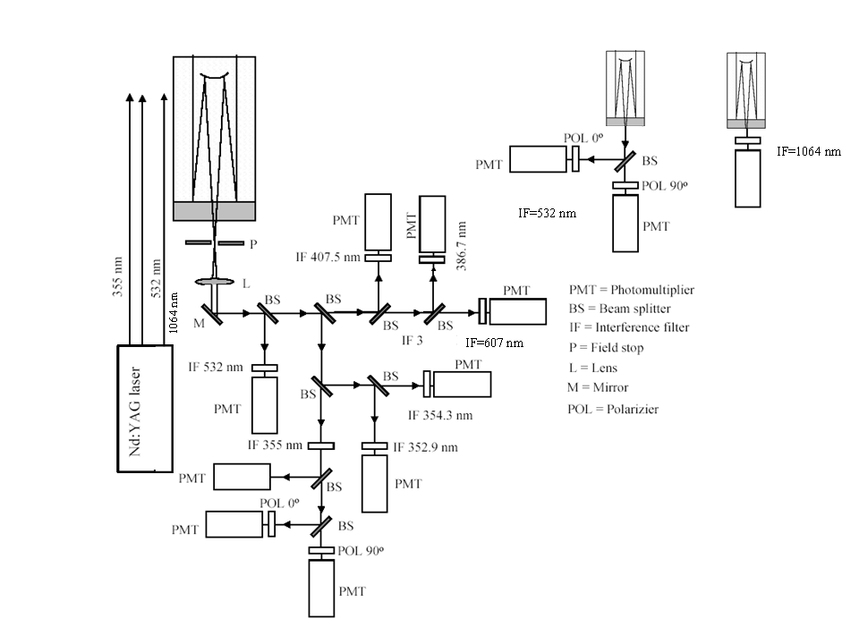
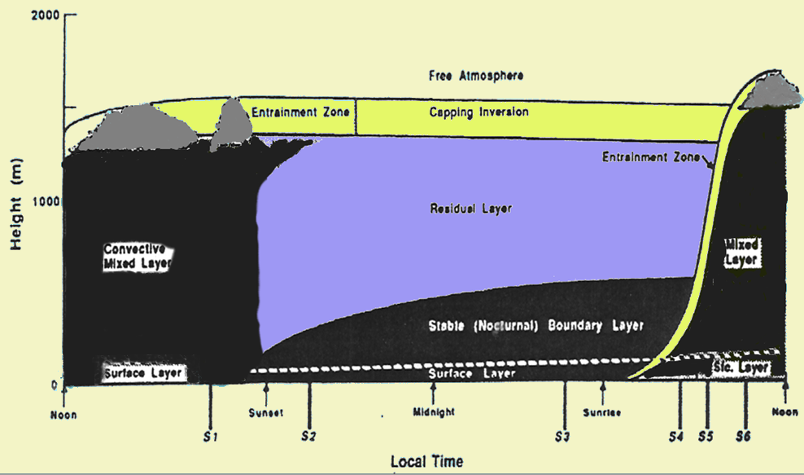
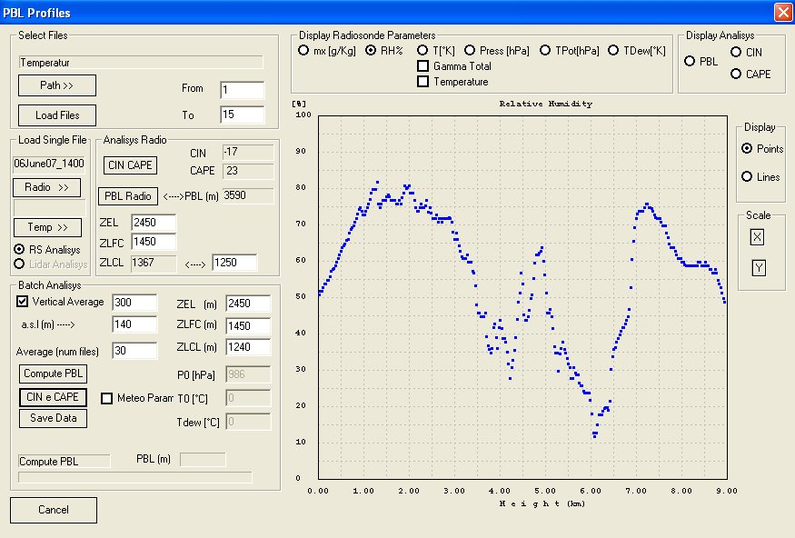
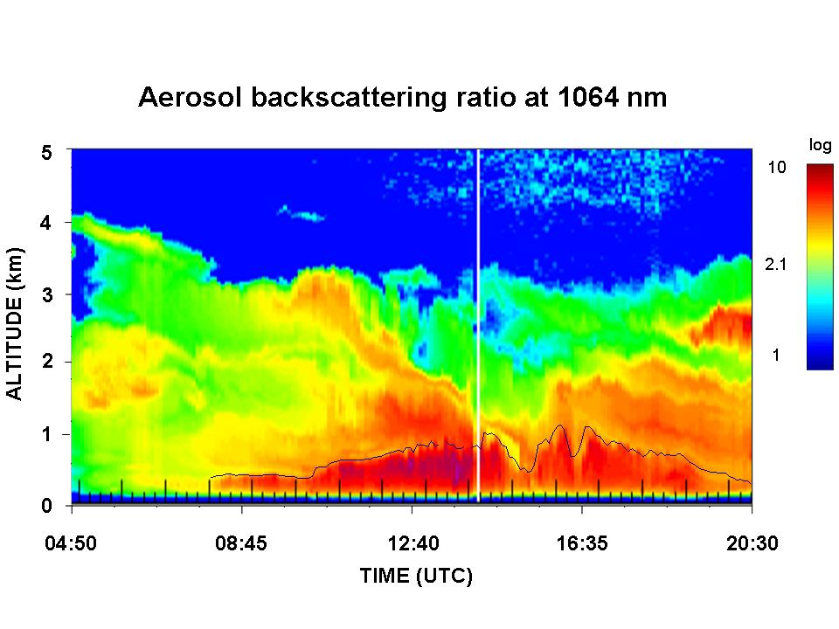
Raman lidar characterization of PBL structure during COPS Donato Summaª, Paolo Di Girolamoª, Dario Stelitanoª, Tatiana Di Iorio^{b} ª DIFA, Univ. della Basilicata, Viale dell'Ateneo Lucano n. 10, 85100 Potenza, Italy,
phone: +39-0971-205134, fax: +39-0971-205160, E-mail:summa@unibas.it, digirolamo@unibas.it, stelitano.dario@gmail.com ^{b} Dipartimento di Fisica, Univ. di Roma “La Sapienza”, Piazzale Aldo Moro, 2, 00100 Roma, Italy, E-mail: tatianadiiorio@gmail.com.
ABSTRACT
The planetary boundary layer includes the portion of the atmosphere which is directly influenced by the presence of the Earth's surface. Aerosol particles trapped within the PBL can be used as tracers to study boundary-layer vertical structure and time variability. As a result of this, elastic backscatter signals collected by lidar systems can be used to determine the height and the internal structure of the PBL. Our analysis considers a method based on the first order derivative of the range-corrected elastic signal, which is a modified version of the method defined by Seibert et al. (2000) and Sicard et al. (2006).
The analysis is focused on selected case studies collected by the Raman lidar system BASIL during the Convective and Orographically-induced Precipitation Study, held in Southern Germany and Eastern France in the period June-August 2007.
Estimates of the PBL height and structure for specific case studies obtained from the above mentioned approach are compared with simultaneous estimates obtained from potential temperature profiles determined from the radiosondes launched simultaneously to lidar operation. Additional estimates of the boundary layer height and structure are obtained from rotational Raman lidar signals used for the temperature measurements. Preliminary results from these comparisons are illustrated and discussed in this poster.
BASIL LIDAR SYSTEM
The University of BASILicata Raman Lidar system (BASIL). The major feature of BASIL is represented by its capability to perform high-resolution and accurate measurements of atmospheric temperature and water vapour, both in daytime and night-time, based on the application of the rotational and vibrational Raman lidar techniques in the UV (Di Girolamo et al., 2004). Besides temperature and water vapour, BASIL provides measurements of the particle backscattering coefficient at 355, 532 and 1064 nm, of the particle extinction coefficient at 355 and 532 nm and of particle depolarization at 355 and 532 nm.
Collected data are feeded into the analysis program used for the estimate of the PBL height
Fig 1. Scheme of the Basil receiver system
Fig 2. The evolution of the structure of PBL in the atmosphere, highlighting the presence of the Mixed Layer, the Residual Layer and the Nocturnal Mixed Layer
Fig. 3: Graphical User Interface used for the analysis of the input raw data.
RESULTS
SUMMARY
The present work compares estimates of the PBL height for specific case studies as obtained from three distinct methods. The first approach (approach 1) considers a method based on the first order derivative of the range corrected elastic signal, which is a modified version of the method defined by Seibert and Sicard.
Potential temperature profiles, Tpot(z), obtained from the radiosondes launched simultaneously to lidar operation, are also be used to get additional estimates of the boundary layer height. Additional estimates of the boundary layer height and structure are obtained from lidar temperature signals (approach 2).
These good agreement between the different approaches support us on the applicability of the present techniques and the possibility to apply them to different case study characterized by different meteorological conditions.
Potential temperature profiles, T_{pot}(z), obtained from the radiosonde data
Consider the quantity: D(z)=d/dz[ln(P_{λ}(z)z²)]
The minima of the quantity D(z) identify the transitions between different layers where Pλ(z) is the elastic lidar signal (1064nm) or rotational Raman signals used to quantify atmospheric temperature.
First maximum of the derivative of T_{pot}(z)
Compute the minima of the D(z)
In the figure the continous lines identify the estimates obtained from approach 1, while the yellow symbols represent the estimates obtained from the potential temperature profiles of the radiosondes. The blue squares represent the estimates obtained from approach 2 for 30 July.
For the purpose of the application of approaches 1 and 2, for the signals Pλ_{Hij}(z) and Pλ_{Loj}(z) we used an integration time of 30 min and a vertical resolution is 300 m, which allowed to reduce signal statistical fluctuations which could affect their applicability.
Fig. 5: Time evolution of the particle backscattering ratio at 1064 nm as measured by BASIL from 07:15 to 19:45 UT on 30 July 2007. The black line in the figure represents the PBL height as determined through the application of approach 1.
Fig. 6: Time evolution of the particle backscattering ratio at 1064 nm as measured by BASIL from 04:50 to 20:00 UT on 15 July 2007. The black line in the figure represents the PBL height as determined through the application of approach 1.
REFERENCES
Di Girolamo, P., R. Marchese, D. N. Whiteman, B. B. Demoz, 2004. Rotational Raman Lidar measurements of atmospheric temperature in the UV, Geophysical Research Letters 31, L01106
Seibert P, Beyrich F, Gryning SE, Joffre S, Rasmussen A, Tercier P., Review and Intercomparison of Operational Methods for the Determination of the Mixing Height, Atmos. Environ. 34: 1001-1020, 2000.
Sicard M, Pérez C, Rocadembosch F, Baldasano JM, Garcìa-Vizcaino D., Mixed layer determination in the Barcelona coastal area from regular lidar measurements: methods, results and limitations, Boundary Layer Meteorology 119 (1): 135-157, 2006.
Fig. 4: Evolution of the PBL height for 15 and 30 July 2007.

